Slide 1

Classifying Good Loans
Craig Bentzen

Slide 2
Problem Statement
Lending Club is a online lending marketplace that allows borrowers to connect with one or multiple creditors.
Lending Club provides historical financial data on borrowers and default rates on existing loans.
With the data that Lending Club provides to creditors is it possible to classify borrowers that are good investments with limited financial risk?

Slide 3
Source Data
Source - Kaggle.com - Data from 2016 (Data pulled in 2019)
Why these dates? - The shortest term of loan is three years. So we need to go back three years to make sure we capture full term loans.
Why this project? - I’m always interesting in financial markets and determining if something is a good investment.
Initial Shape: 434,407 Rows 151 Columns

Slide 4
Data Wrangling
The first step in data wrangling was to sync the backend data set to fields viewable in the front end.
Lending Club provides data descriptions on the data set and this was used to sync the fields. Any field in the data set that is not available on the platform front end was removed.

Slide 5
Data Wrangling
The following tasks were also performed:
Handling Null Values
Removal of outliers on the Interest Rate Field
Removal of unnecessary columns or fields
Final Number of Features: 42

Slide 6
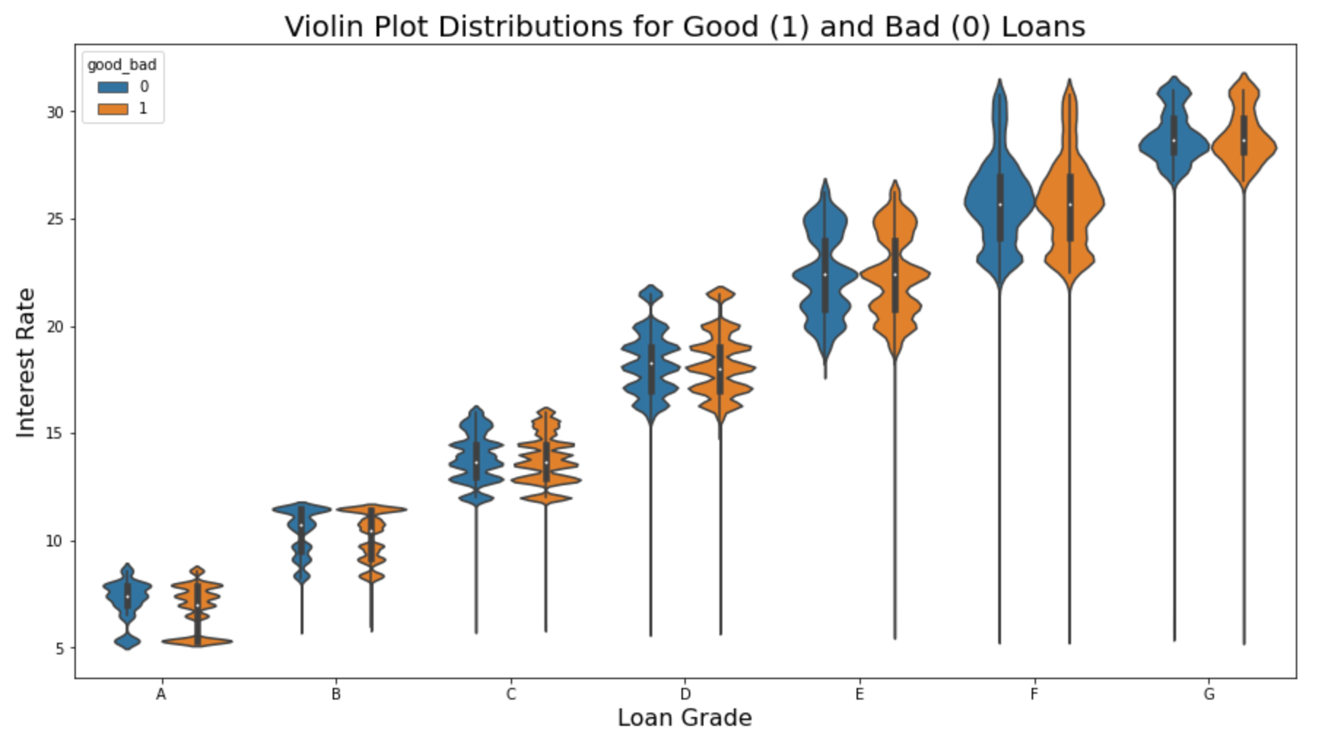
Exploratory Data Analysis
Interest Rates are Tiered with Loan Grade
Some loans have a low interest rate for some reason but it is hard to tell if they are outliers

Slide 7
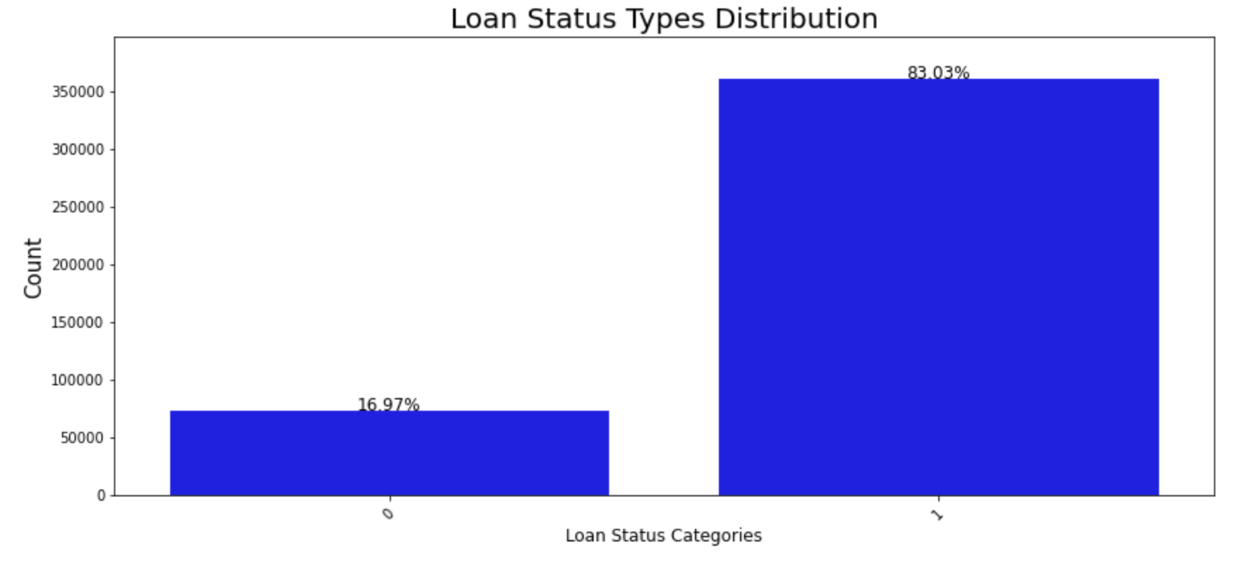
Exploratory Data Analysis
Majority of loans are in Good Standing - Imbalance Data Set
If 2013 had more data, it might be interesting to see the difference in default rates. Many of the 5 year term loans are still open.

Slide 8
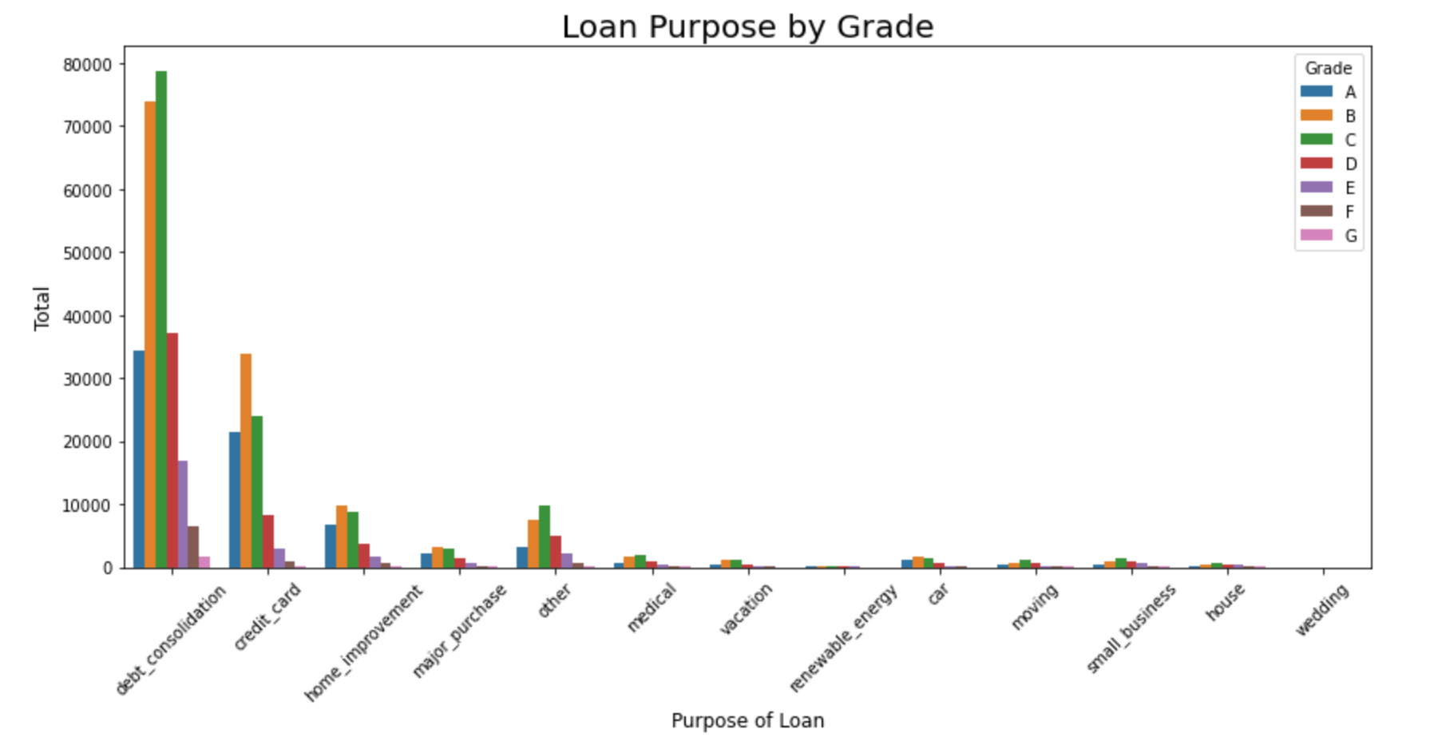
Exploratory Data Analysis
Higher proportion of D Grade Debt is used for Debt Consolidation

Slide 9
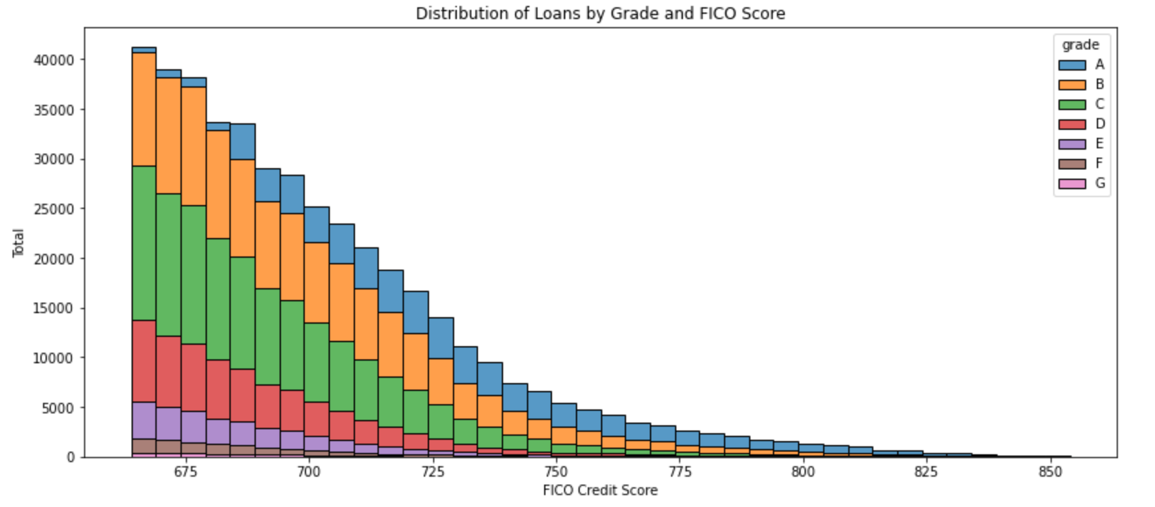
Exploratory Data Analysis
Distribution is highly skewed to the right
Minimum FICO score is 660
As FICO increases the proportion of A Grade Loans increase

Slide 10
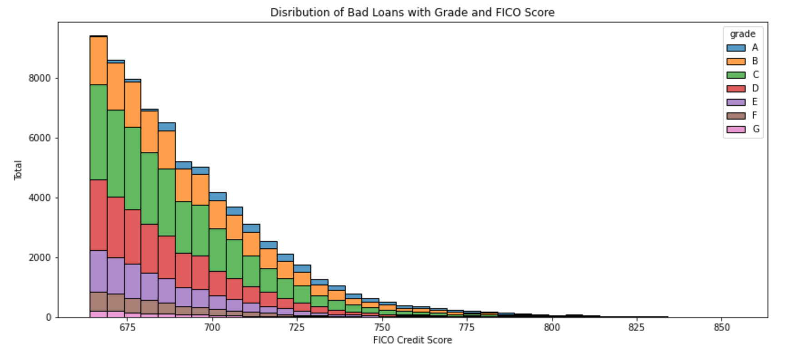
Exploratory Data Analysis
Majority of Bad Loans have a Credit Score below 750

Slide 11
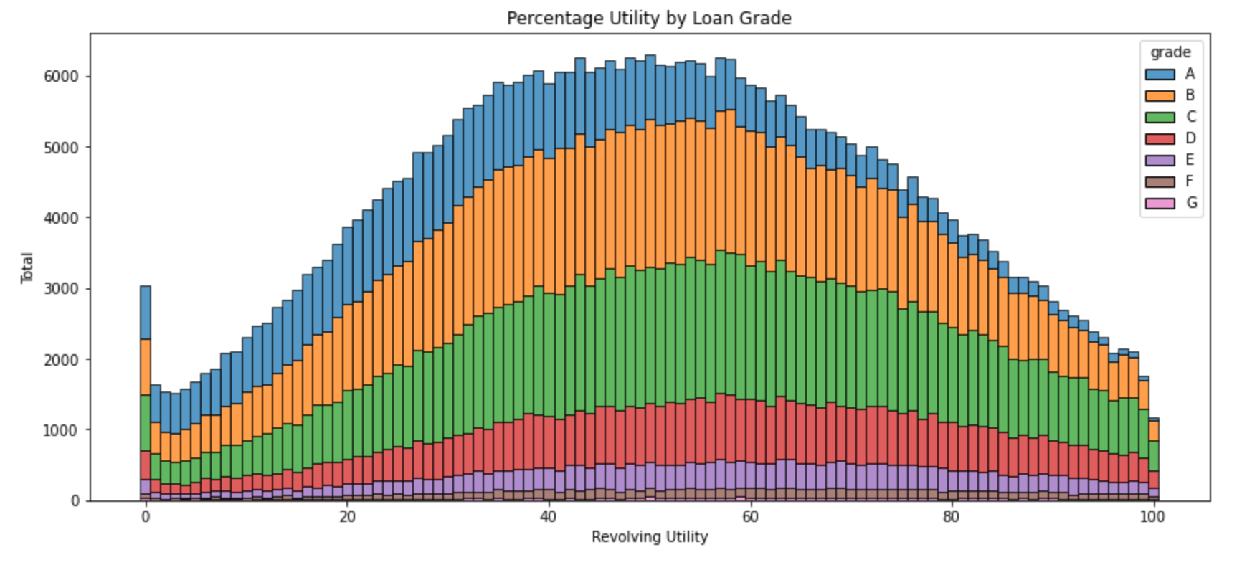
Exploratory Data Analysis
Grade A Borrowers Use less of their available Credit

Slide 12
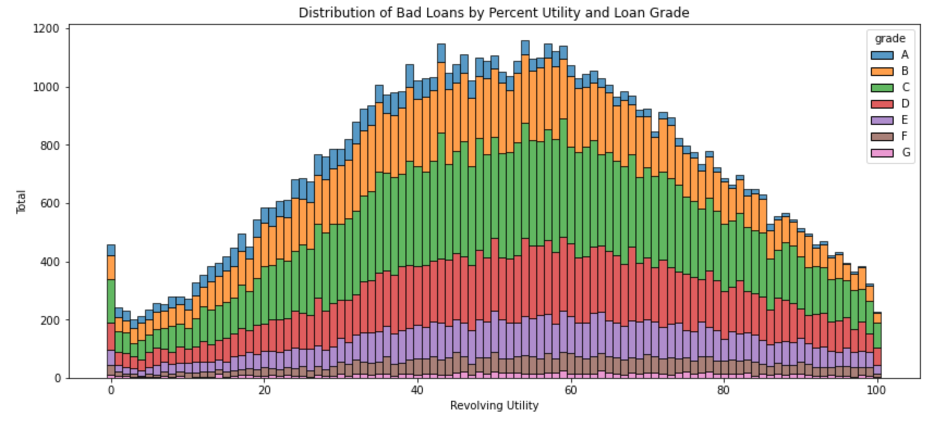
Exploratory Data Analysis
Is Flattening Occuring?

Slide 13
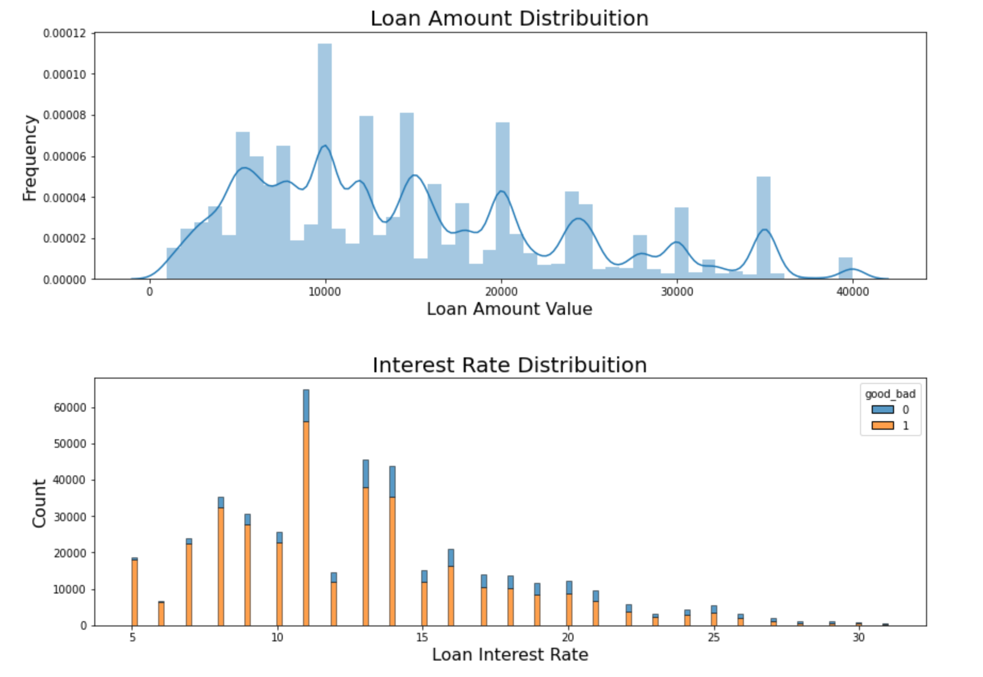
Exploratory Data Analysis
Distribution of loan amount is multi-peaked
As interest rate increases the proportion of bad loans increases

Slide 14
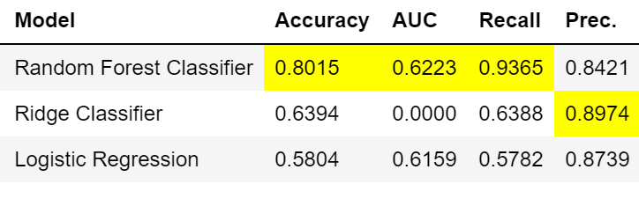
Data Modeling - Initial Findings
Random Forest and Ridge Regression both perform well.
Used SMOTE method

Slide 15
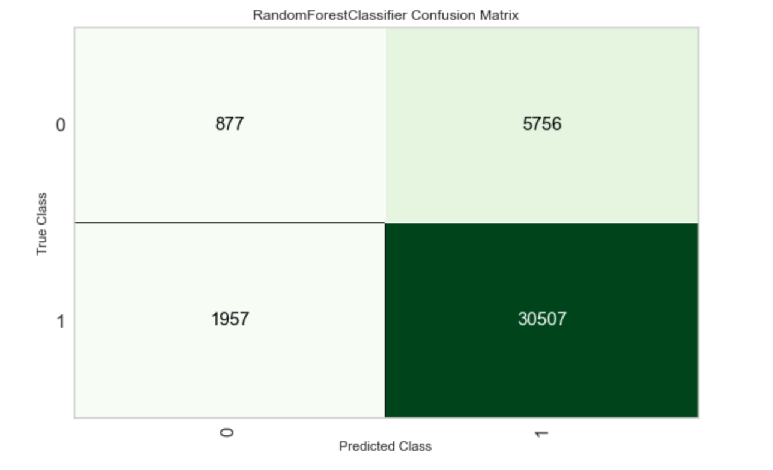
Data Modeling - Random Forest
We will evaluate these models by reducing the number of False Positive. A FP means we lose our money.
This means this model is wrong 15.8% of the time

Slide 16
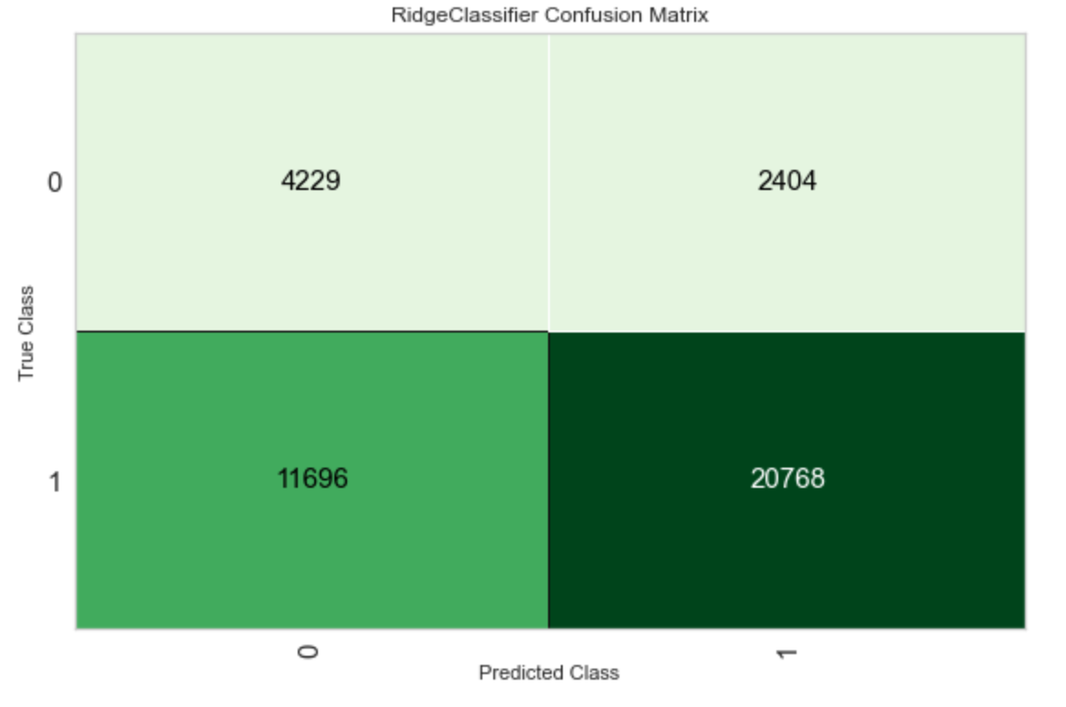
Data Modeling - Ridge
Ridge Regression is incorrect
This means this model is wrong 10.3% of the time when predicting a good loan

Slide 17
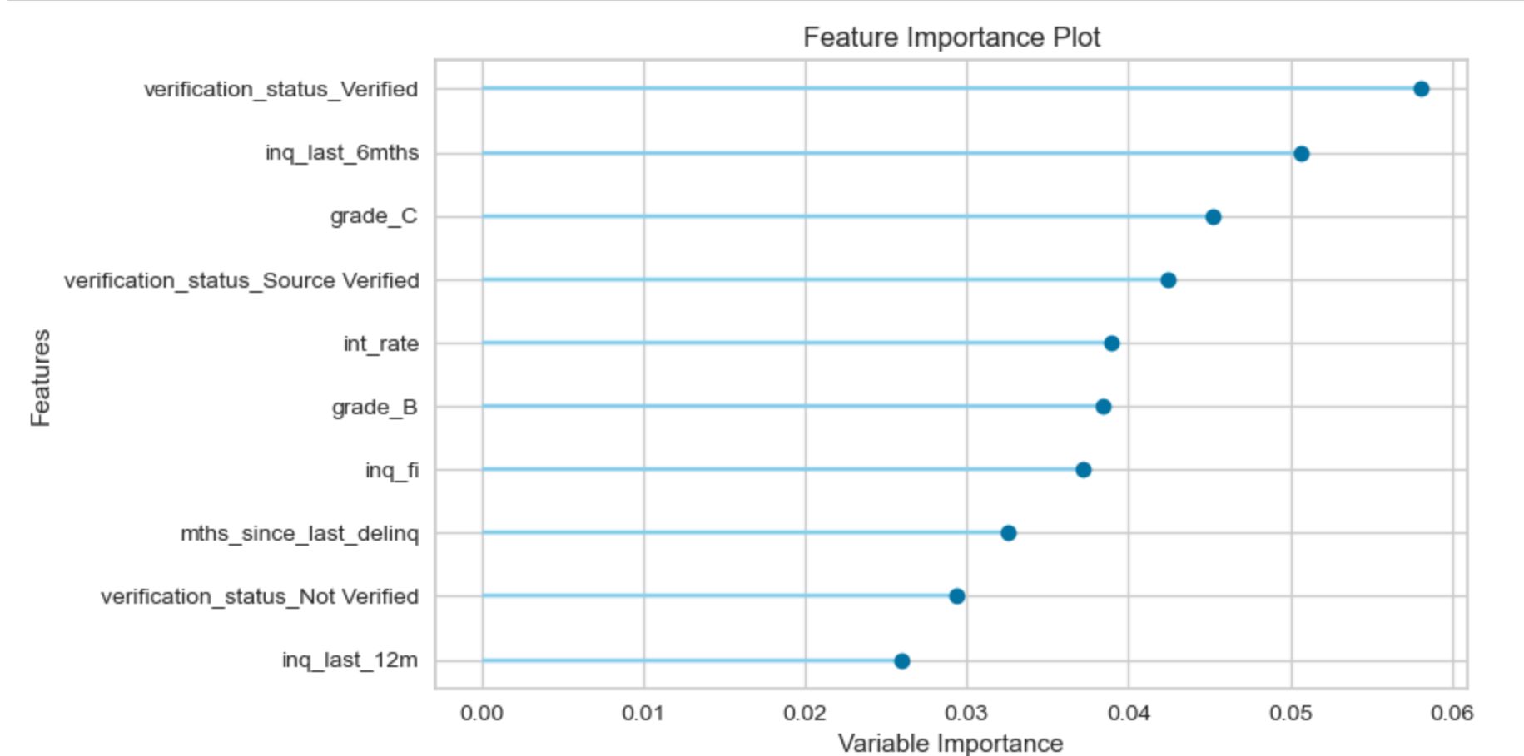
Data Modeling - Random Forest Feature Importance
These values seams to make sense

Slide 18
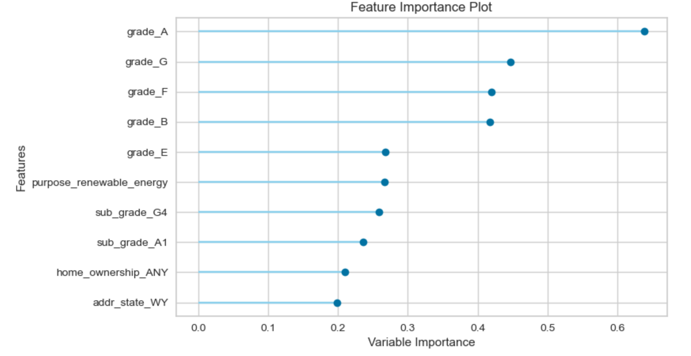
Data Modeling - Ridge - Feature Importance
The features that make Ridge bettor at reducing FP don’t make sense to me.

Slide 19
Data Modeling - RF and Ridge Broken Out by Loan Grade
At High Grades like A both models perform well.
At Grade C both models perform poorly for me to want to invest in a C or lower loan.
Grade | RF - % False Positive | Ridge - % False Positive
A | 5.51% | 4.50%
B | 11.57% | 8.74%
C | 18.23% | 14.83%
D | 25.87% | 22.60%
E | 32.40% | 31.07%
F | 39.19% | 37.13%
G | 40.91% | 41.49%

Slide 20
Data Modeling - Conclusions
Investing in A or B grade loans seem like acceptable investments.
Anything C or higher is too risky for my investing taste.
Ridge Regression performs slightly better and I want to better understand why that is.

Slide 21
Further Research
Oversampling so both classes are equal
If I knew more about the data functionality I would do some feature engineering
Split out 60 Month term loans and 36 Month term loans

